Slide 1
Chapter 3: The Project Management Process Groups
Information Technology Project Management, Ninth Edition
Note: See the text itself for full citations

Slide 2
Learning Objectives
Describe the five project management process groups, the typical level of activity for each, and the interactions among them
Understand how the project management process groups relate to the project management knowledge areas (mapping)
Discuss how organizations develop information technology (IT) project management methodologies to meet their needs

Slide 3
Learning Objectives
Describe the five project management process groups, the typical level of activity for each, and the interactions among them
Understand how the project management process groups relate to the project management knowledge areas (mapping)
Discuss how organizations develop information technology (IT) project management methodologies to meet their needs

Slide 4
Learning Objectives
Review a case study of an organization applying the project management process groups to manage an IT project, describe outputs of each process group, and understand the contribution that effective initiating, planning, executing, monitoring and controlling, and closing make to project success
Review the same case study of a project managed with an agile focus to illustrate the key differences in approaches
Describe several templates for creating documents for each process group

Slide 5
Project Management Process Groups
The foundation for project management theory is called process groups.
But although it sounds complicated, process groups are simply phases that each project goes through
Project Manager is involved from the beginning till the end.

Slide 6
Project Management Process Groups
A process is a series of actions directed toward a particular result
Project management can be viewed as a number of interlinked processes
The project management process are grouped in five PMPG include
initiating processes
planning processes
executing processes
monitoring and controlling processes
closing processes
Notes:
Assumption: Project charter (budget, scope, time lime, ressource, scope)
A project plan, project charter and/or project scope may be put in writing, outlining the work to be performed.
During this phase, a team should prioritize the project, calculate a budget and schedule, and determine what resources are needed.
Create a project plan (mobilize, templates)
Monitor the progress

Slide 7
Project Management Process Groups
Initiating Process Group.
The process(es) performed to define a new project or a new phase of an existing project by obtaining authorization to start the project or phase.
Planning Process Group.
The process(es) required to establish the scope of the project, refine the objectives, and define the course of action required to attain the objectives that the project was undertaken to achieve.
Executing Process Group.
The process(es) performed to complete the work defined in the project management plan to satisfy the project requirements

Slide 8
Project Management Process Groups
Monitoring and Controlling Process Group.
The process(es) required to track, review, and regulate the progress and performance of the project; identify any areas in which changes to the plan are required; and initiate the corresponding changes.
Closing Process Group. The process(es) performed to formally complete or close a project, phase, or contract

Slide 9
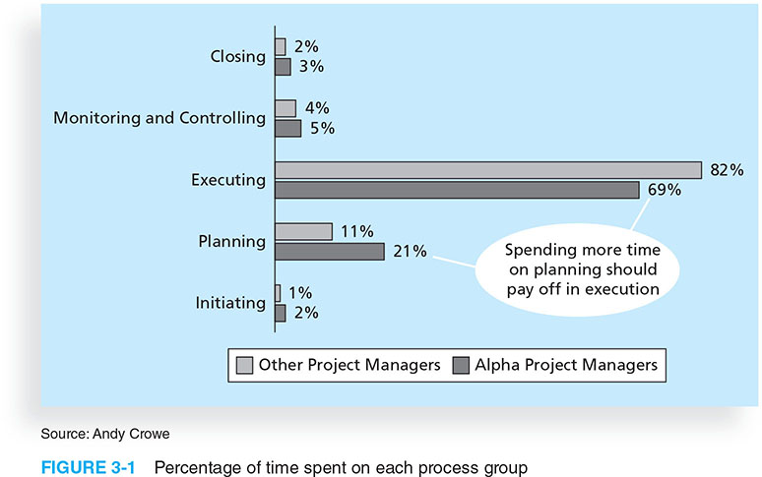
Figure 3-1. Percentage of Time Spent on Each Process Group

Slide 10
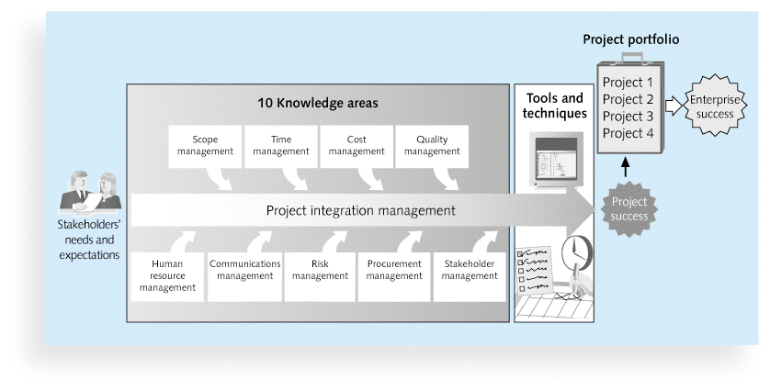
10 Knowledge areas

Slide 11
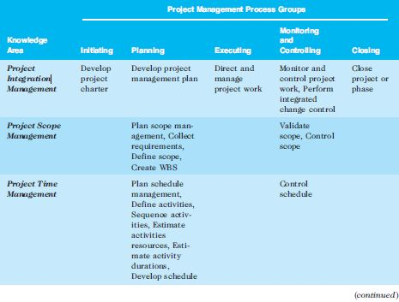
Mapping Project Management Process Groups to Knowledge Areas (mapping)
*Source: PMBOK® Guide, Fifth Edition, 2013.

Slide 12
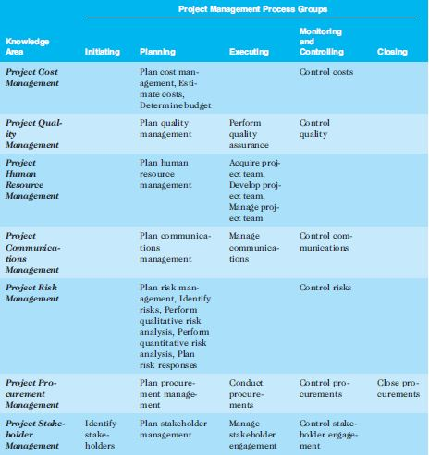
Continued (mapping)

Slide 13
Developing an IT Project Management Methodology
Just as projects are unique, so are approaches to project management
Many organizations develop their own project management methodologies, especially for IT projects
A methodology describes how things should be done; a standard describes what should be done
PRINCE2, Agile, RUP, and Six Sigma provide different project management methodologies

Slide 14
Project Management Process Groups
A process is a series of actions directed toward a particular result
Project management can be viewed as a number of interlinked processes
The project management process groups include
initiating processes
planning processes
executing processes
monitoring and controlling processes
closing processes
Notes:
Assumption: Project charter (budget, scope, time lime, ressource, scope)
A project plan, project charter and/or project scope may be put in writing, outlining the work to be performed.
During this phase, a team should prioritize the project, calculate a budget and schedule, and determine what resources are needed.
Create a project plan (mobilize, templates)
Monitor the progress

Slide 15
1. Project Pre-initiation
It is good practice to lay the groundwork for a project before it officially starts
Senior managers often perform several pre-initiation tasks, including the following:
Determine the scope, time, and cost constraints for the project
Identify the project sponsor
Select the project manager
Develop a business case for a project (see Table 3-2 for an example)
Meet with the project manager to review the process and expectations for managing the project
Determine if the project should be divided into two or more smaller projects

Slide 16

Project Initiation
Initiating a project includes recognizing and starting a new project or project phase
The main goal is to formally select and start off projects
Table 3-3 shows the project initiation knowledge areas, processes, and outputs

Slide 17
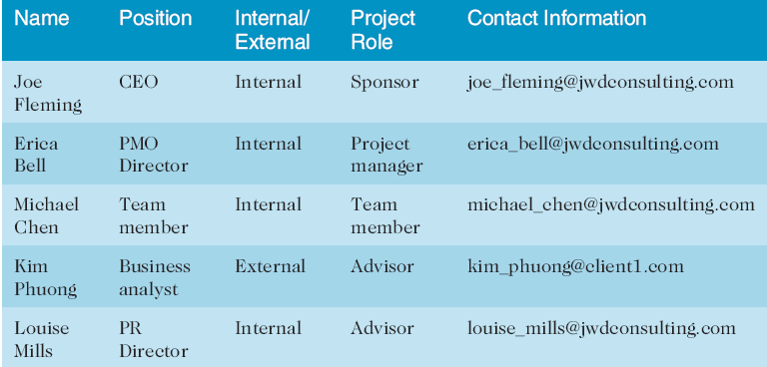
Stakeholder Register

Slide 18
PROJECT CHARTER
The project charter is the document issued by the project initiator or sponsor that formally authorizes the existence of a project and provides the project manager with the authority to apply organizational resources to project activities.
It documents the high-level information on the project and on the product, service, or result the project is intended to satisfy.
At a high level, the project charter ensures a common understanding by the stakeholders of the key
deliverables, milestones, and the roles and responsibilities of everyone involved in the project.

Slide 19
PROJECT CHARTER
Project purpose
High-level requirements
High-level project description, boundaries, and key deliverables
Overall project risk;
Summary milestone schedule
Preapproved financial resources
Key stakeholder list
Project exit criteria (i.e., what are the conditions to be met in order to close or to cancel the project or phase)
Assigned project manager, responsibility, and authority level
Name and authority of the sponsor or other person(s) authorizing the project charter.

Slide 20
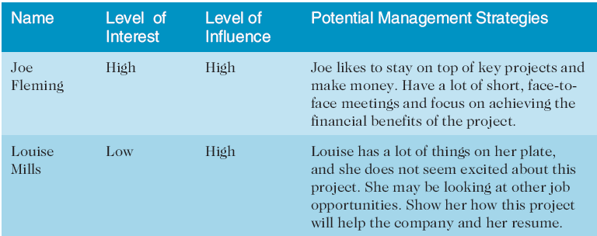
Stakeholder Management Strategy
Contents are often sensitive, so do not publish this document.

Slide 21
Project Charters and Kick-off Meetings
Charters are normally short and include key project information and stakeholder signatures
It’s good practice to hold a kick-off meeting at the beginning of a project so that stakeholders can meet each other, review the goals of the project, and discuss future plans

Slide 22
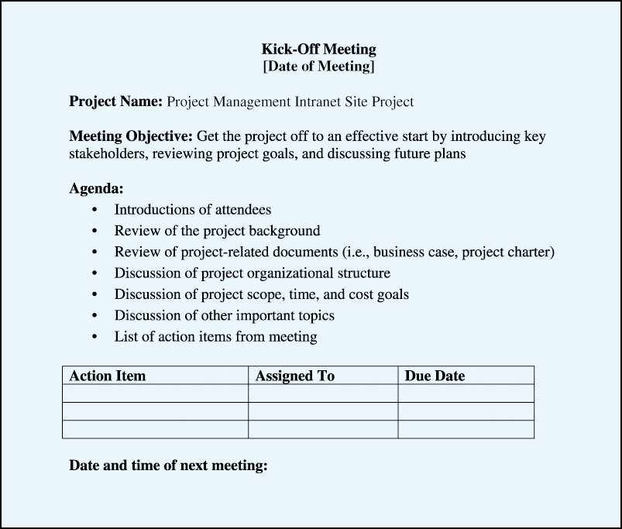
Kick-off Meeting Agenda

Slide 23
2. Project Planning
The main purpose of project planning is to guide execution
Every knowledge area includes planning information (see Table 3-7 on pages 98-99)
Key outputs included in the JWD project include:
A team contract
A project scope statement
A work breakdown structure (WBS)
A project schedule, in the form of a Gantt chart with all dependencies and resources entered
A list of prioritized risks (part of a risk register)
See sample documents starting on p. 101

Slide 24
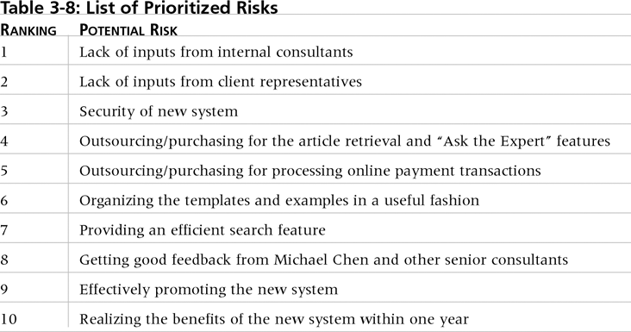
List of Prioritized Risks

Slide 25
3. Project Executing
Usually takes the most time and resources to perform project execution
Project managers must use their leadership skills to handle the many challenges that occur during project execution
Table 3-11 lists the executing processes and outputs. Many project sponsors and customers focus on deliverables related to providing the products, services, or results desired from the project
A milestone report can help focus on completing major milestones

Slide 26
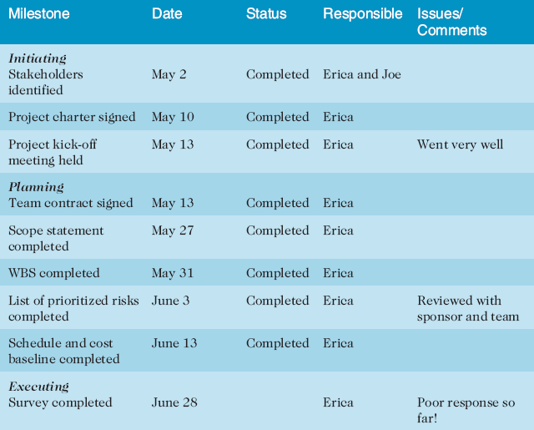
Part of Milestone Report

Slide 27
4. Project Monitoring and Controlling
Involves measuring progress toward project objectives, monitoring deviation from the plan, and taking correction actions
Affects all other process groups and occurs during all phases of the project life cycle
Outputs include performance reports, change requests, and updates to various plans

Slide 28
5. Project Closing
Involves gaining stakeholder and customer acceptance of the final products and services
Even if projects are not completed, they should be closed out to learn from the past
Outputs include project files and lessons-learned reports, part of organizational process assets
Most projects also include a final report and presentation to the sponsor/senior management

Slide 29
An Informed Decision
It is not a snap decision whether to use an agile approach or not, just like flying or driving somewhere on a trip
Projects with less rigid constraints, experienced and preferably co-located teams, smaller risks, unclear requirements, and more flexible scheduling would be more compatible with an agile approach
The following example uses Scrum roles, artifacts, and ceremonies

Slide 30
Agile software development processes Covered Yesterday!
An approach to managing projects that includes an iterative workflow and incremental delivery of software in short iterations

Slide 31
Agile Software Development Processes
Scrum
scalable process for managing software projects
one of the best project management frameworks
for handling rapidly changing or evolving projects
particularities: technology or requirements uncertainty
product don’t pass from team to team – simultaneous
product get worked in parallel by all teams

Slide 32
Scrum has been used
Commercial software
Financial applications
In-house Development
Embedded Systems
Video game development
Mobile phones
Websites
Network applications
Satellite-control software
Etc.

Slide 33
Characteristics
Self-organizing teams
Product progresses in a series of month-long “Sprints”
Requirements are captured and itemized in a list “product blacklog”
No specific engineering practice has to be used

Slide 34
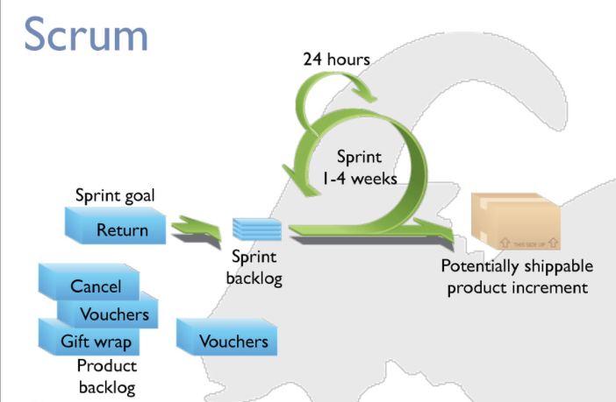
Scrum www.mountaingoatsoftware.com

Slide 35
Scrum: Sprints
Progress is made in a series called “sprints”
Duration 2-4 weeks or at most a month
Product is designed, coded, and tested during the “sprint”
Overlapping development rather than sequential
Requirement
Design
Coding
Testing
No changes during a sprint – Plan for how long to keep the change out of the sprint.

Slide 36
Scrum Framework
Roles
Product owner
ScrumMaster
Team
Ceremonies
Sprint planning
Sprint review
Sprint retrospective
Daily scrum meeting
Artifacts
Product backlog
Spring backlog
Burndown charts

Slide 37
Product Owner
Defines the features of the product
Defines scope and schedule decisions
Responsible for financial goals
Prioritize the product backlog
Adjust features and priorities in every sprint as needed
Accepts or reject work results

Slide 38
Scrum Master
Responsible for enacting Scrum pratices
Coaches the team Defines the features of the product
Defines scope and schedule decisions
Responsible for financial goals
Prioritize the product backlog
Adjust features and priorities in every sprint as needed
Accepts or reject work results
Enable close cooperation across teams

Slide 39
The Team
Typically 5-9
Cross-functional:
Programmers, testers, designers, etc.
Members should be full-time (except database admin)
Team are self-organizing
Membership should change only between sprints.

Slide 40
Scrum Framework
Roles
Product owner
ScrumMaster
Team
Ceremonies
Sprint planning
Sprint review
Sprint retrospective
Daily scrum meeting
Artifacts
Product backlog
Spring backlog
Burndown charts

Slide 41
Sprint Planning
Team selects item from the backlog they can complete
Sprint backlog is created
Tasks are identified (1-16 hours)
Collaborating, not done alone by ScrumMaster
High-level design is considered

Slide 42
Sprint review
Team presents their accomplishments during the sprint
Typically, demo of new features or underlying design/architecture
Informal
2-hour prep
In general no slides
Whole team participate

Slide 43
Sprint retrospective
Take a look at what is working and not working
Around 30 minutes
Done after every sprint
Whole team participates
ScrumMaster
Product owner
Team
Customers, sponsors, users, others
Many ways to do a sprint retrospective
Start doing → Stop doing → Continue

Slide 44
Daily Scrum
Daily 15-minutes
Stand-up
Team members, Scrum Master, product owner
Avoid unnecessary meetings
Not problem solving
Everyone answers 3 questions:
What did you accomplish?
What will you be doing?
Is there anything/problem to discuss?

Slide 45
Artifacts : A useful object created by people
Roles
Product owner
ScrumMaster
Team
Ceremonies
Sprint planning
Sprint review
Sprint retrospective
Daily scrum meeting
Artifacts
Product backlog
Spring backlog
Burndown charts

Slide 46
Product backlog
The requirements
List of all desired needs of the project
Each item has a priority/value to the customers
Reprioritize at the start of each sprint
Example:
Backlog item Estimation
All guests can make reservation 3
All guests can cancel reservation 3
Online help……….
…
Exception handling 10

Slide 47
Sprint backlog
Tasks M T W TH F
Code user interface 4 5 7 8 9
Test the middle Tier 16 . . . . . . .
Write online help
Write Zombie Class
Write error logging Class .. .. . . . . . .

Slide 48
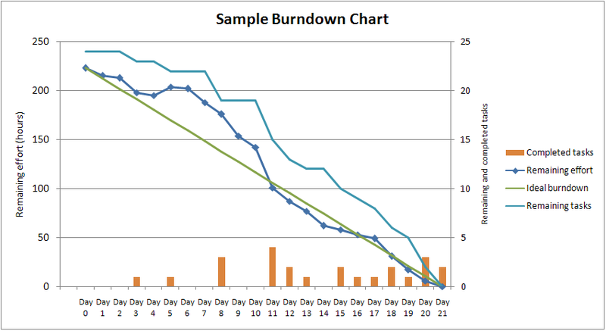
Burndown Chart
chart that shows the cumulative work remaining in a sprint on a day-by-day basis
Image from: http://en.wikipedia.org/wiki/File:SampleBurndownChart.png

Slide 49
Managing the sprint backlog
Team members sign up for work of they prefer/choose
Work is never assigned
Estimated work remaining is updated daily
If work is not clear, define/refine/update /break it down aby any team

Slide 50
Scrum Roles
Product owner: The person responsible for the business value of the project and for deciding what work to do and in what order, as documented in the product backlog.
ScrumMaster: The person who ensures that the team is productive, facilitates the daily Scrum, enables close cooperation across all roles and functions, and removes barriers that prevent the team from being effective.
Scrum team or development team: A cross-functional team of five to nine people who organize themselves and the work to produce the desired results for each sprint, which normally lasts 2-4 weeks.

Slide 51
Scrum Artifacts
An artifact is a useful object created by people
Scrum artifacts include:
Product backlog: A list of features prioritized by business value
Sprint backlog: The highest-priority items from the product backlog to be completed within a sprint
Burndown chart: Shows the cumulative work remaining in a sprint on a day-by-day basis

Slide 52
Scrum Ceremonies
Sprint planning session: A meeting with the team to select a set of work from the product backlog to deliver during a sprint.
Daily Scrum: A short meeting for the development team to share progress and challenges and plan work for the day.
Sprint reviews: A meeting in which the team demonstrates to the product owner what it has completed during the sprint.
Sprint retrospectives: A meeting in which the team looks for ways to improve the product and the process based on a review of the actual performance of the development team.

Slide 53
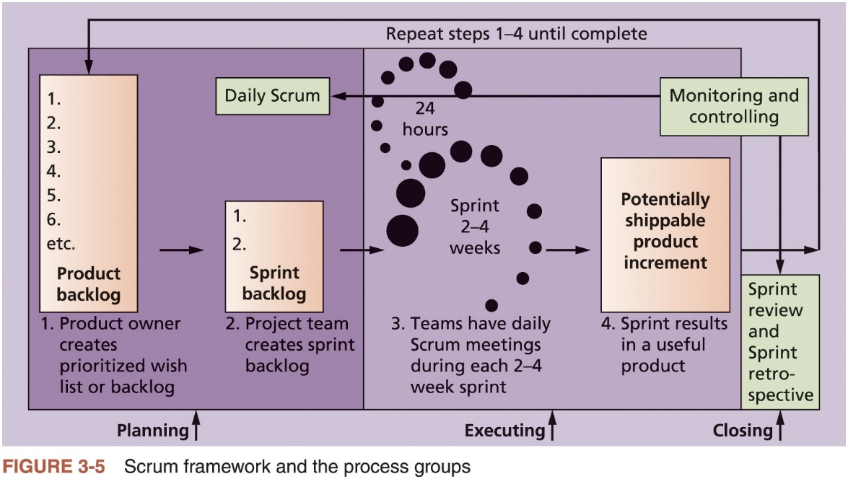
Scrum Roles, Artifacts, and Ceremonies

Slide 54
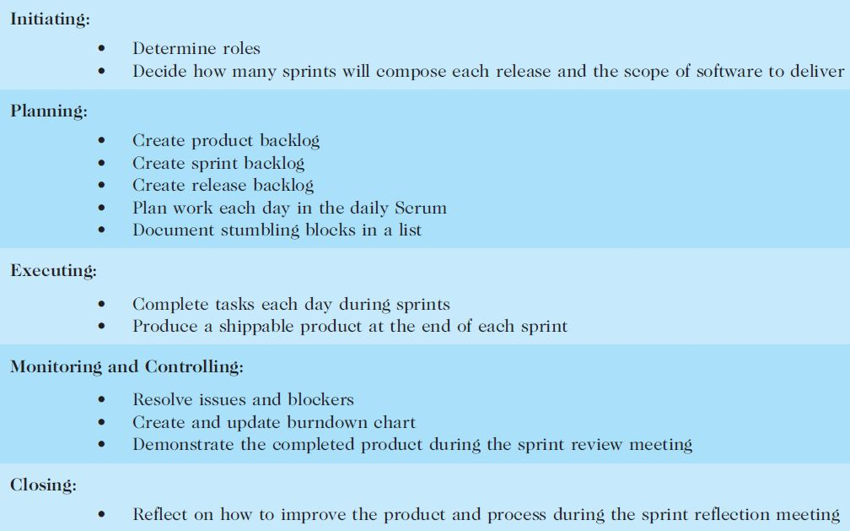
Table 3-18. unique Scrum Activities by Process Group

Slide 55
Planning
Not different from PMBOK® Guide
Still create a scope statement and can use a Gantt chart for the entire project schedule; other planning similar (risk, etc.)
Different:
Descriptions of work are identified in the product and sprint backlogs, more detailed work documented in technical stories, estimate a velocity or capacity for each sprint; release roadmap often used for schedule

Slide 56
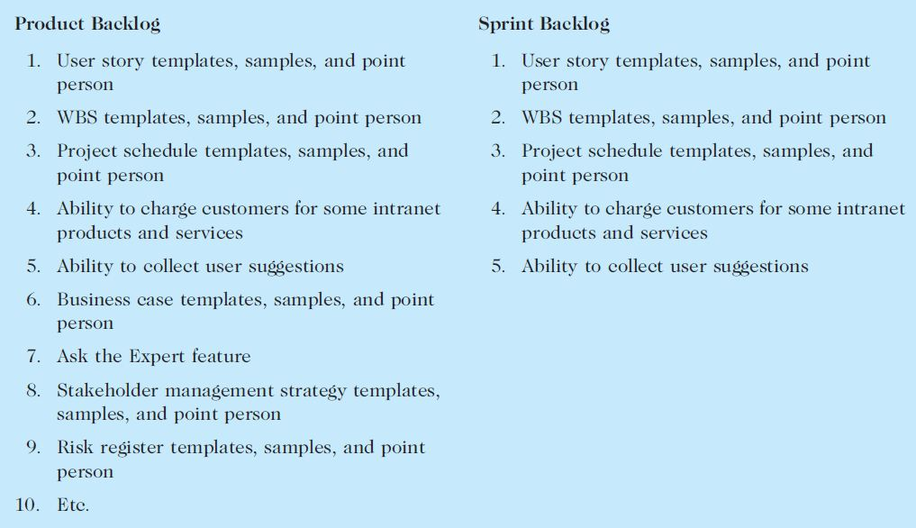
Table 3-19. Product and Sprint Backlogs

Slide 57
Executing
Not different from PMBOK® Guide
Still produce products, lead people, etc.
Different:
Produce several releases of software - users of the new software might be confused by getting several iterations of the product instead of just one
Communications different because the project team meets every morning, physically or virtually

Slide 58
Monitoring and Controlling
Not different from PMBOK® Guide
Still check actual work vs. planned work
Different
Names of key reviews are the daily Scrum and the sprint review
A sprint board is used instead of a tracking Gantt chart or other tools
Use a burndown chart vs. earned value chart

Slide 59
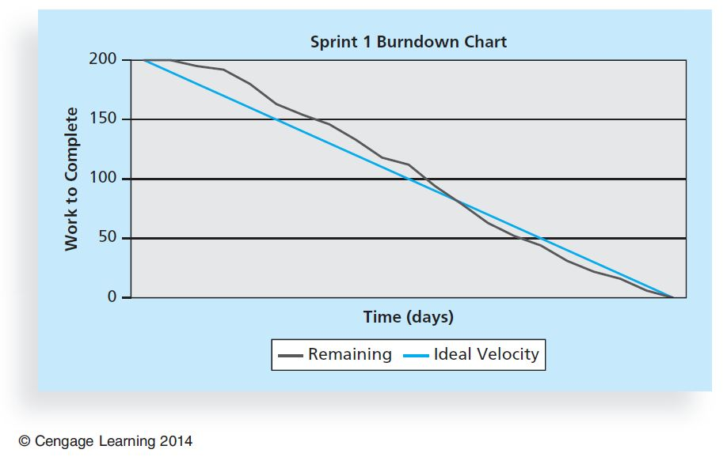
Figure 3-7. Burndown Chart

Slide 60
Closing
Not different from PMBOK® Guide
Focus is still on acceptance of deliverables and reflection
Different:
The retrospective is similar to a lessons-learned report, but it focuses on a shorter period of time. It is intended to answer two fundamental questions:
What went well during the last sprint that we should continue doing?
What could we do differently to improve the product or process?

Slide 61
Chapter Summary
The five project management process groups are initiating, planning, executing, monitoring and controlling, and closing
You can map the main activities of each process group to the nine knowledge areas
Some organizations develop their own information technology project management methodologies
The JWD Consulting case study provides an example of using the process groups and shows several important project documents
The second version of the same case study illustrates differences using agile (Scrum). The biggest difference is providing three releases of useable software versus just one

